Slide 1
DSP Lab9 Mel-Frequency Cepstral Coefficients
TA：彭玉淮、王俊棋、陳邦尹

Slide 2
Flow Diagram
Short Time Fourier Transform
Pre-emphasis
Frame blocking
Hamming window
Fast Fourier Transform
Triangular Band-pass Filtering
Log energy
Discrete cosine transform
MFCC

Slide 3
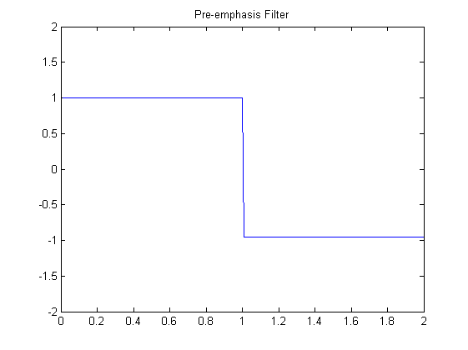
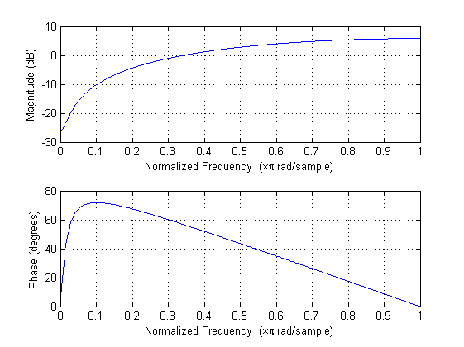
Pre-emphasis & STFT
x_emp = filter([1,-0.95],1,x);
S = spectrogram(x_emp,window,noverlap,nfft,fs);

Slide 4
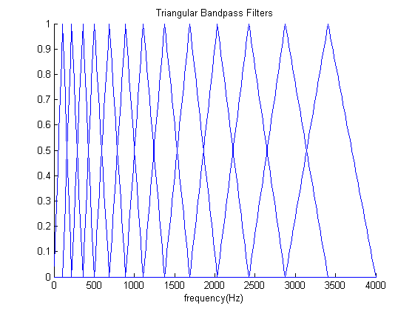
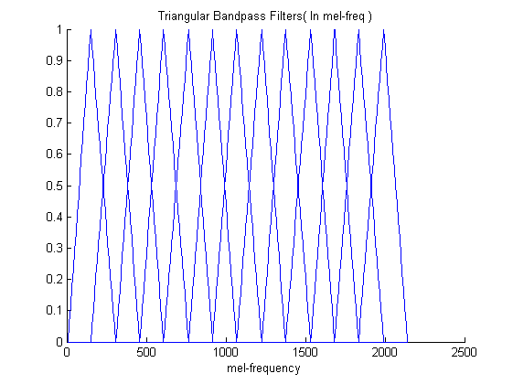
Triangular Band-pass Filtering
tmp = TBFilter*(abs(X_fft).^2);
MFCC = dct(log(tmp));

Slide 5
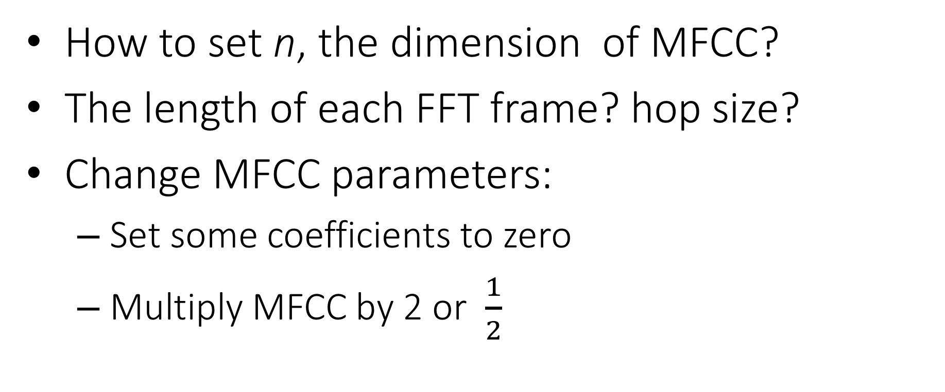
Exercises
How to set n, the dimension of MFCC?
The length of each FFT frame? hop size?
Change MFCC parameters:
Set some coefficients to zero
Multiply MFCC by 2 or $\frac{1}{2}$

Slide 6
Record your sound
sec = 2;
fs = 8000;
recorder = audiorecorder(fs, 16, 1);
%audiorecorder(Fs, nBits, nChannels)
recordblocking(recorder, Sec);
x = getaudiodata(recorder);
sound(x,fs);

Slide 7
Fundamental Setting
n = ???; % number of mel energy bands
% Frame + Window + FFT
dur = ???; % sec
hopsize = ???;

Slide 8
How to call function?
Please read the MFCC.m, invMFCC.m
function [mfcc,W] = MFCC(MagSpec, n, Nframes, fs, Nfft)
function [z] = invMFCC(mfcc, W, n, Nframes, fs, frame_len, frame_shift, z)

Slide 9
Demo
Record [ a ], [ i ], [ u ], [ ɛ ], [ ɔ ] by yourself.
Choose a good setting of MFCC empirically.
Determine the smallest n that makes synthesis audio still can be recognized. Please show audio to TA.
Apply a filter(High, Bandpass, Low) to MFCC.

